Slide 1
3-2 politics in the 18th century (1700s)

Slide 2
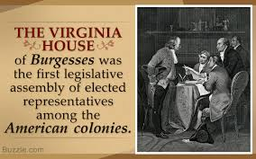
I. By 1750, all 13 colonies
A) Had similar govt’s –
Executive & Legislatures
B) Executives
C) Legislatures
D) Taxes
E) Local governments
New England Unique

Slide 3
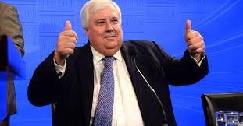
F) Voting In the 18th Century
Who Couldn’t Vote | Who COULD vote
All women Poor white men (owned no property) Slaves Free Black men | White males who owned property *Religious restrictions were mostly removed
My kind of “democracy” for sure!!!
Still…there WAS voting! Pretty unusual in the world then!

Slide 4
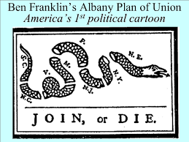
II. The colonies begin to work together
A) The Albany Plan of Union
1) Called for by the British
To organize against the ????
2) Major Player –
3) Never Adopted but set an important precedent

Slide 5
B) Peace of Paris 1763
1) Great Britain:
Acquired French Canada/Spanish Florida
Now dominant in North America
World’s most powerful navy
Took more control of the colonies

Slide 6
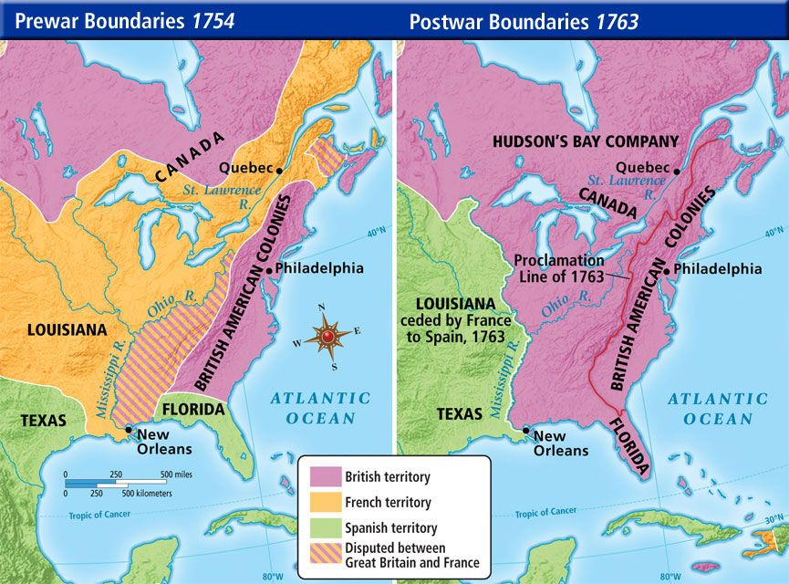

Slide 7
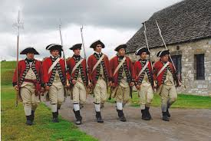
2) The colonies
I wish they would just GO HOME!!!
See no reason for British troops any more
Thought things should go back to “salutary neglect” style

Slide 8
III. Britain takes control
Cute little colonies
A)Proclamation of 1763
B) New Laws designed to…
C) The MOST Important one?

Slide 9
C) Reaction of colonists:
Legislatures/Assemblies complained to the king
Stamp act congress
Boycotts of British goods
Sons and daughters of liberty
Continue to move west in defiance of proclamation of 1763

Slide 10
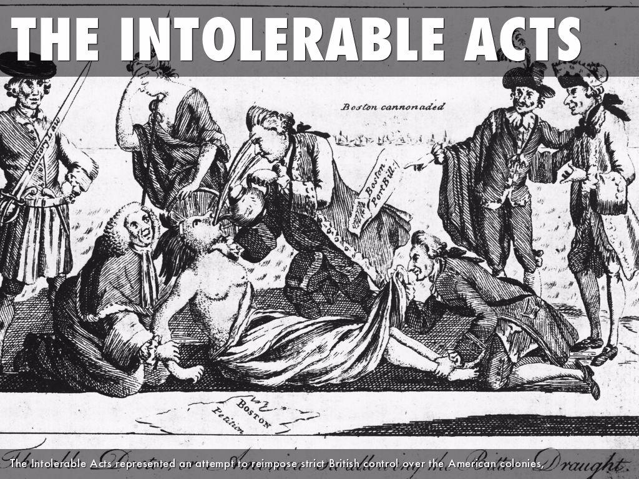
D) Britain continues to tighten the rope
1) Townsend Acts
2) Boston Massacre
3) Boston Tea Party
4)

Slide 11
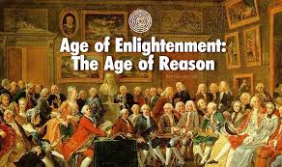
IV. Political Theory and the enlightenment

Slide 12
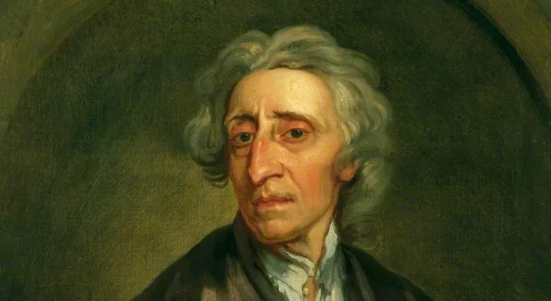
A) John Locke (Oh no, another John!)
The nose knows!
1) Humans have “natural rights”
2) Citizens should revolt
Against a gov’t that does not protect
These rights.

Slide 13
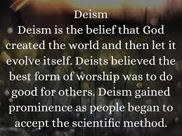
B) Reason not religion

Slide 14
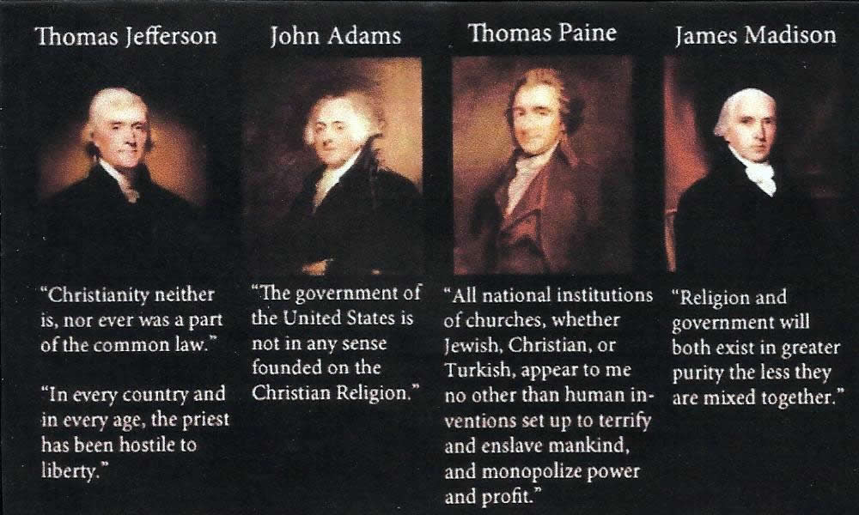
C) Famous deists:

Slide 15
Did the Enlightenment and deism have a lasting impact?
YES!

Slide 16
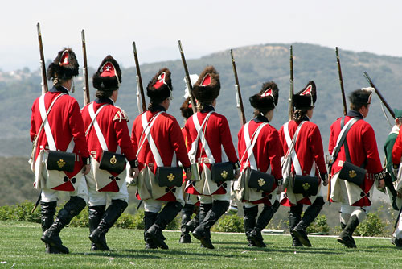
The End!

