Slide 1
2 Videos to show Before Powerpoint: https://youtu.be/zbdFUMToAJo
https://youtu.be/4C_F3-VbI-E

Slide 2
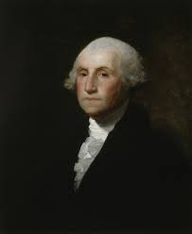
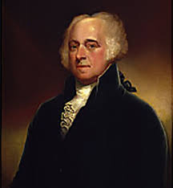
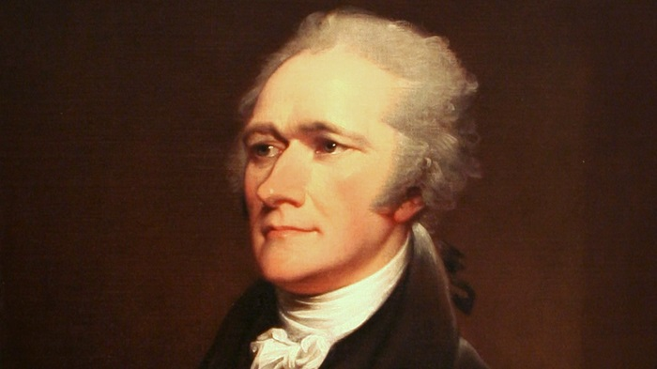
3-6 The First presidents
#1? #2?
Plus Alexander Hamilton

Slide 3
1) WHAT YEAR DID WASHINGTON BECOME PRESIDENT?
A) 1774
B) 1776
C) 1789
D) 1800

Slide 4
2) What was Hamilton’s position in Washington’s cabinet?
A) Secretary of State
B) Secretary of War
C)Attorney General
D) Secretary of Treasury

Slide 5
3) All of the following were Against Hamilton’s plans in this role Except:
A) Federalists
B) Thomas Jefferson
C) Indebted Farmers
D) Anti-Federalists

Slide 6
4) What clause in the constitution did Hamilton believe gave congress the right to create a national bank?
A) “necessary and proper”
B) “pursuit of happiness”
C) “just powers of the governed”
D) “promote the general welfare”

Slide 7
5) What was the Proclamation of Neutrality?
A) It stated that even though the US had fought a war against the British, we would now deal with them as any other country.
B) A reaction to the French Revolution by Washington, stating that the US would not take sides in that conflict.
C) An agreement between Washington and Jefferson that both the Federalist and Anti-Federalists only wanted the best for the young nation.
D) Both A and B

Slide 8
6) Why was the pickney treaty with Spain so important?
A) It stopped all aggression by the Spain Empire towards the US.
B) Encouraged trade between the new US and Spain.
C) Forgave the war debts that some states owed to Spain from the Revolutionary War.
D) Allowed Americans access to the Spain-controlled Lower Mississippi River and New Orleans.

Slide 9
7) Which of the following best describes the Washington administration’s actions toward native americans?
A) Like many times before, Indian tribes tried to resist the advance of Americans but were defeated and gave up the land in the Ohio River Valley.
B) Washington negotiated the Treaty of Greenville which allowed the tribes in the Ohio River Valley to stay on their lands.
C) The US was too new a country to have any real policy toward Native Americans and the Frontier.
D) The government under Washington was too far in debt to do very much about the Indians which led to several tribes retaking land from settlers.

Slide 10
8) How did the whiskey rebellion lead to increased “sectionalism”?
A) It again pitted the small states and large states against each other.
B) Westerns felt that the Federal Government, located in the East, had used too much force against the common people.
C) Slave states felt that they were being discriminated against by Northern states.
D) Washington ignored the Rebellion which angered many Federalists who wanted a strong central government.

Slide 11
9) All of the following are TRUE statements concerning the early establishment of political parties EXCEPT:
A) Hamilton and Jefferson became allies in working the establish the Democratic-Republican party.
B) Whether to support the French Revolution became a major issue between the 2 parties.
C) Democratic-Republicans argued for states rights and a weaker National government.
D) Federalists were strongest in the Northeastern States.

Slide 12
10) In Washington’s farewell address, he advised that the country should not do which of the following?
A) get involved in European Affairs
B) form political parties
C) elect an Anti-Federalist
D) Both A and B

Slide 13
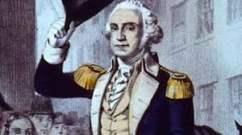
Hats Off to you if you knew most of these answers! If not, you’d better study cause I am important!!!

Slide 14
1) WHAT YEAR DID WASHINGTON BECOME PRESIDENT?
A) 1774
B) 1776
C) 1789
D) 1800

Slide 15
2) What was Hamilton’s position in Washington’s cabinet?
A) Secretary of State
B) Secretary of War
C)Attorney General
D) Secretary of Treasury

Slide 16
3) All of the following were Against Hamilton’s plans in this role Except:
A) Federalists
B) Thomas Jefferson
C) Indebted Farmers
D) Anti-Federalists

Slide 17
4) What clause in the constitution did Hamilton believe gave congress the right to create a national bank?
A) “necessary and proper”
B) “pursuit of happiness”
C) “just powers of the governed”
D) “promote the general welfare”

Slide 18
5) What was the Proclamation of Neutrality?
A) It stated that even though the US had fought a war against the British, we would now deal with them as any other country.
B) A reaction to the French Revolution by Washington, stating that the US would not take sides in that conflict.
C) An agreement between Washington and Jefferson that both the Federalist and Anti-Federalists only wanted the best for the young nation.
D) Both A and B

Slide 19
6) Why was the pickney treaty with Spain so important?
A) It stopped all aggression by the Spain Empire towards the US.
B) Encouraged trade between the new US and Spain.
C) Forgave the war debts that some states owed to Spain from the Revolutionary War.
D) Allowed Americans access to the Spain-controlled Lower Mississippi River and New Orleans.

Slide 20
7) Which of the following best describes the Washington administration’s actions toward native americans?
A) Like many times before, Indian tribes tried to resist the advance of Americans but were defeated and gave up the land in the Ohio River Valley.
B) Washington negotiated the Treaty of Greenville which allowed the tribes in the Ohio River Valley to stay on their lands.
C) The US was too new a country to have any real policy toward Native Americans and the Frontier.
D) The government under Washington was too far in debt to do very much about the Indians which led to several tribes retaking land from settlers.

Slide 21
8) How did the whiskey rebellion lead to increased “sectionalism”?
A) It again pitted the small states and large states against each other.
B) Westerners felt that the Federal Government, located in the East, had used too much force against the common people.
C) Slave states felt that they were being discriminated against by Northern states.
D) Washington ignored the Rebellion which angered many Federalists who wanted a strong central government.

Slide 22
9) All of the following are TRUE statements concerning the early establishment of political parties EXCEPT:
A) Hamilton and Jefferson became allies in working the establish the Democratic-Republican party.
B) Whether to support the French Revolution became a major issue between the 2 parties.
C) Democratic-Republicans argued for states rights and a weaker National government.
D) Federalists were strongest in the Northeastern States.

Slide 23
10) In Washington’s farewell address, he advised that the country should not do which of the following?
A) get involved in European Affairs
B) form political parties
C) elect an Anti-Federalist
D) Both A and B

Slide 24
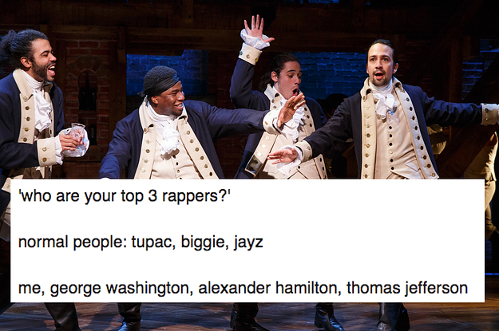
Hamilton brings in 1.9 million per week in ticket sales – pretty good for a guy who used to be worth only….

Slide 25
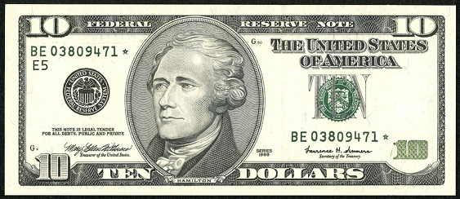

Slide 26
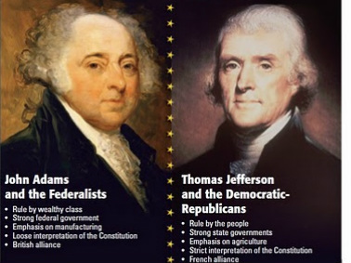
I. John Adams - #2
A) Next Election was…

Slide 27
B) Adams wins and TJ becomes…
C) 12 th amendment (1804) …

Slide 28
II. The First Political Parties:
 | A) Federalists | B) Democratic-Republicans (formerly known as Anti-Federalists)
Leaders | Adams, Hamilton | Jefferson, Madison
View of the Constitution | Interpret Loosely Strong Central Gov’t | Interpret Strictly Weak Central Gov’t
Foreign Policy | Pro-British | Pro-French
Military Policy | Grow Large peacetime army/navy | Small army/navy
Economic Policy | High Tariffs, National Bank, Business focus | Oppose Tariffs & National Bank Focus on Agriculture
Supporters | Northern Business Owners | Small Farmers, Plantation Owners Newer Immigrants

Slide 29
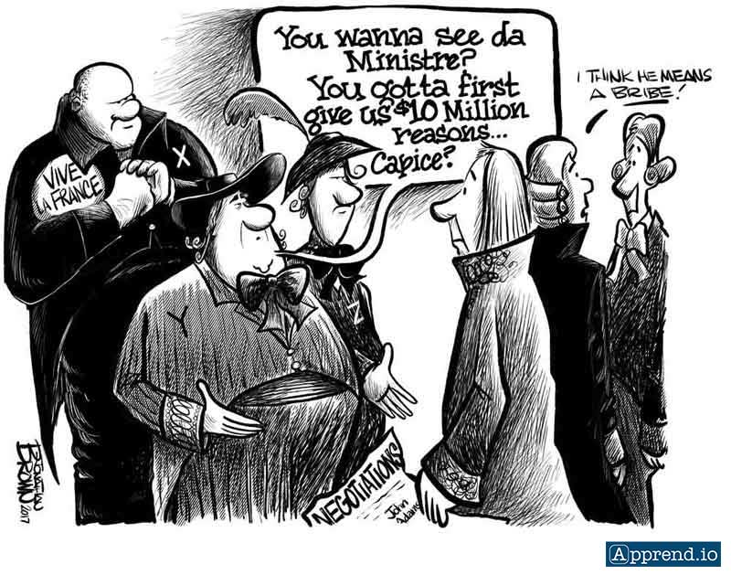
III. Adam’s Presidency
XYZ Affair –
Hamilton…
Led to…

Slide 30
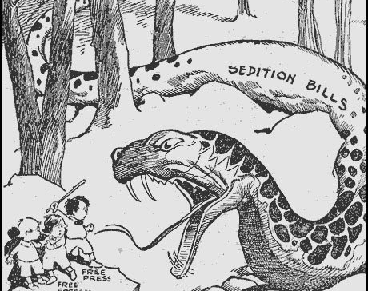
B) Alien & Sedition Acts (1798)
Federalists pass laws to restrict the Democratic-Republicans (many immigrants):
-Naturalization Act – increased from 5 to 14 years to apply for citizenship
-Alien Acts – deportation…
-Sedition Act – made it illegal for newspapers to criticize the president or congress.

Slide 31
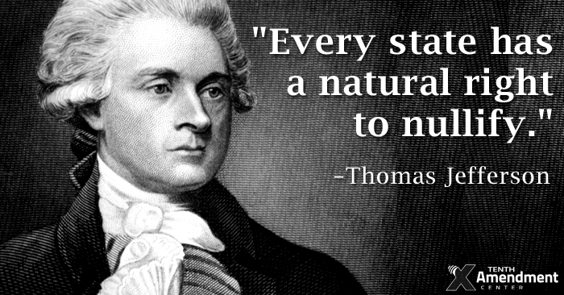
C) Kentucky and Virginia Resolutions (Jefferson & Madison)
1) Demo-Rep. Saw these laws as violating…
2) No “Judicial Review” yet
3) State Legislatures – “compact is broken” therefore “nullification”.

Slide 32
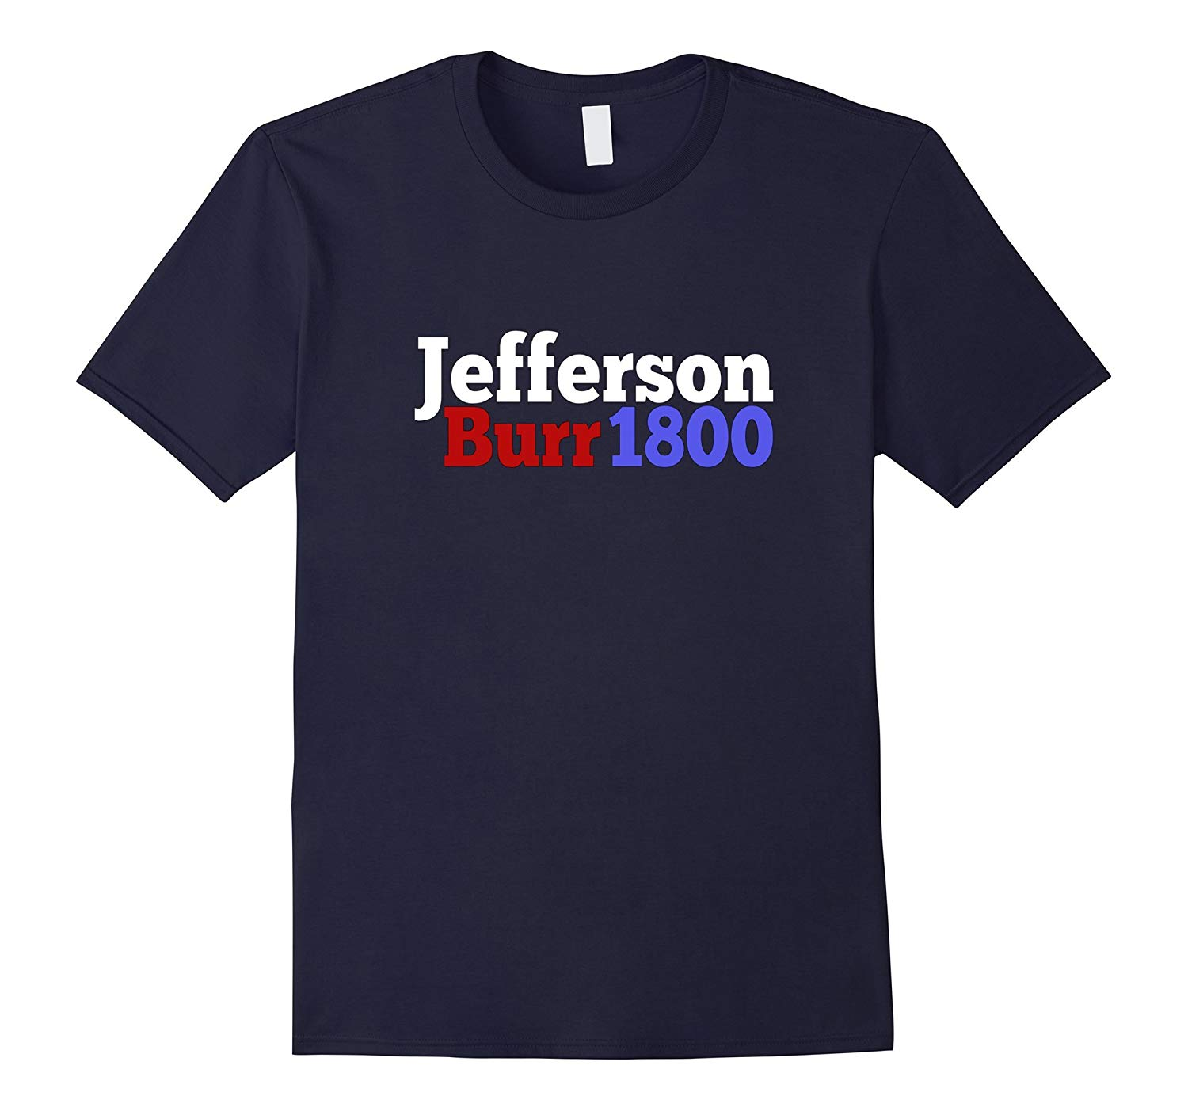
IV. Election of 1800
Federalists
lost popularity. Why?
B) Thomas Jefferson
and Aaron Burr…

Slide 33
C)
because…

Slide 34
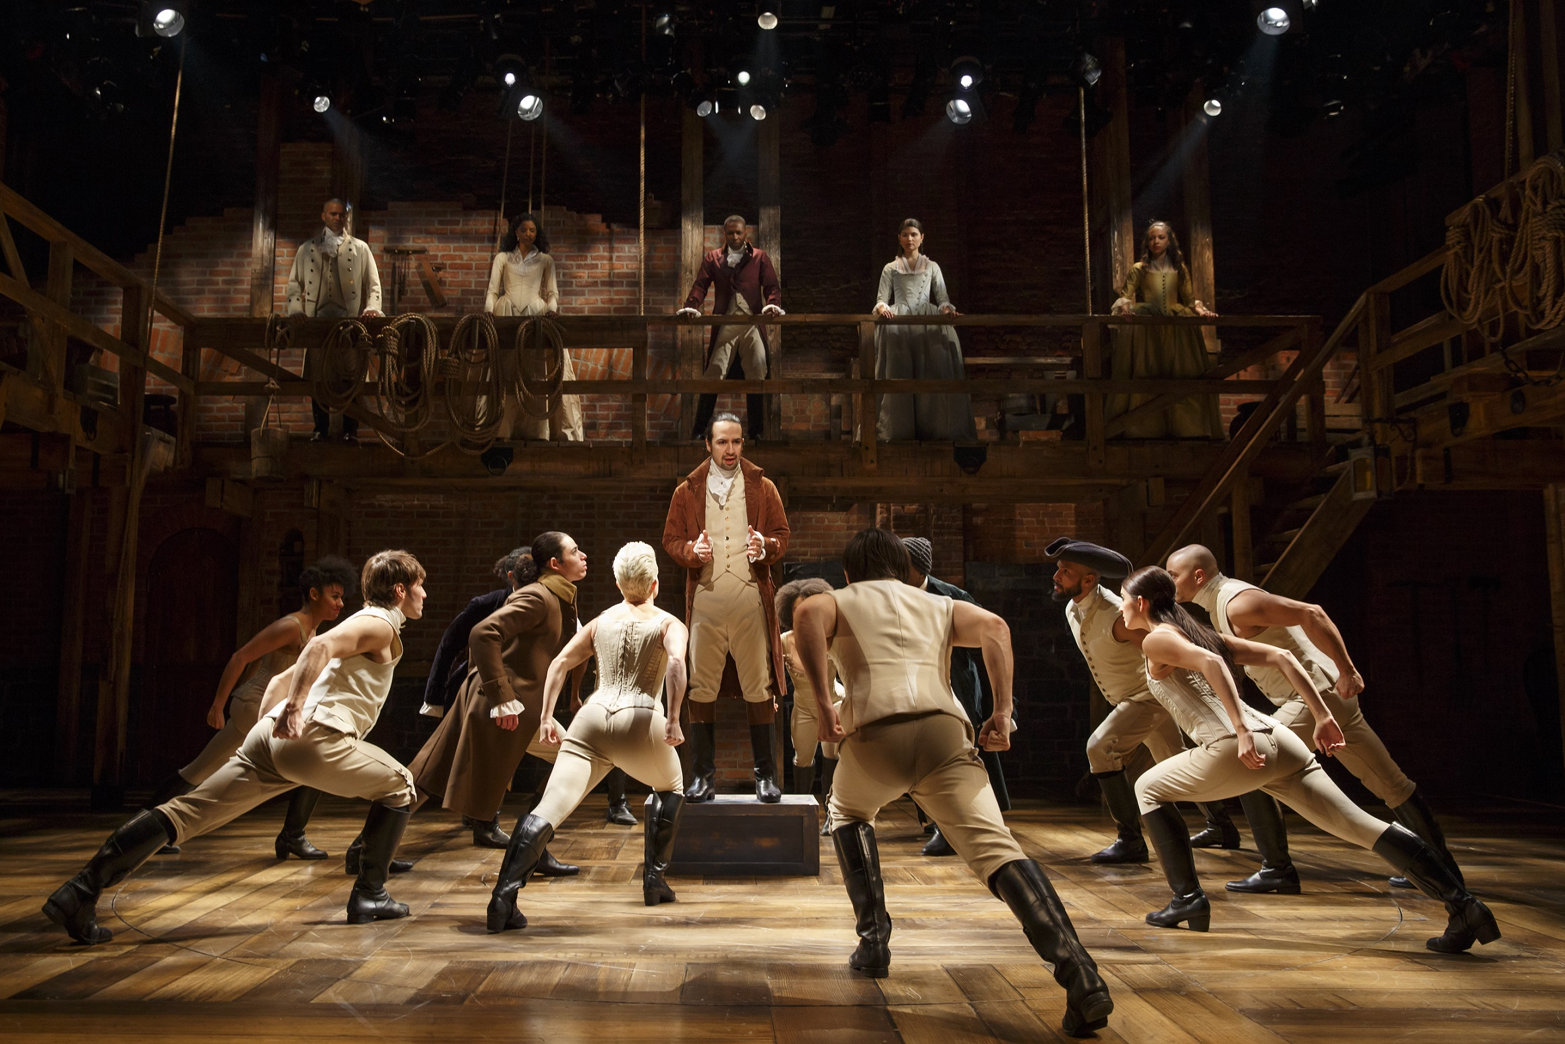
The End!

