Slide 1
Re
3 - 3
Begins!
1774-1776

Slide 2
Stop – Muppets time!!!!
https://youtu.be/aAVpj_Vo7zk

Slide 3
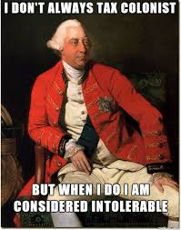
I. First Continental Congress
A) 1774 – Intolerable Acts were…
B) All colonies (except Georgia) sent delegates
to meeting in Philadelphia
C) Purpose?

Slide 4
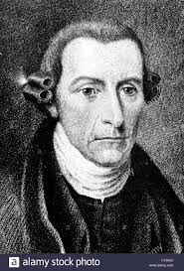
D) Delegates:
My name is Patrick and I’m too sexy for these curls!
Group Name: | Radical | Moderates | Conservatives
Stand:
Examples: | Patrick Henry Samuel Adams John Adams | George Washington John Dickinson | John Jay Joseph Gallaway
Left out? Loyalists aka Tories –
would not challenge the king or parliament in any way

Slide 5
E) Actions:
1 –Suffolk Resolves (Massachusetts) - repeal of Intolerable Acts, boycotts & Military preparation.
2 – Declaration and Resolves (Virginia/moderates) called for king to “redress” (make right).
3 – Created the “Association” - network of committees, to enforce boycotts
4 –meet again in May of 1775 if needed.
NO ONE WAS THINKING ABOUT REVOLUTION YET!!!

Slide 6
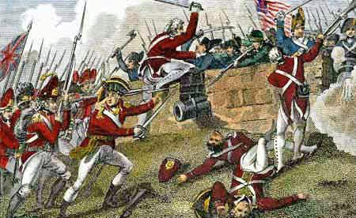
ii. Let the fighting begin!
A) Britain’s response – Declare Mass. in revolt, send in troops
B) “Shot Heard Round the World” Lexington &Concord
1) Who Knows? 2) British embarrassed by “minutemen”
C) Bunker Hill
2 months later – first “true battle” Bunker Hill
**Videos on AmericansRus

Slide 7
III. 2nd Continental Congress
A) “Conflicted” Group!
WAGING WAR (New England) | SEEKING PEACE (Middle Colonies)
-Call on colonies to send troops -Washington made Commander-in-chief -Sent Benedict Arnold to raid Quebec -Organized an American Navy | -Valued their British heritage -Send “Olive Branch Petition” to King George III
Some now want Revolution, some still don’t until…

Slide 8
B) King George Declares all colonies in rebellion and parliament stops all trade.

Slide 9
C)
Written by Thomas Paine –IMPORTANT!!!!!!

Slide 10
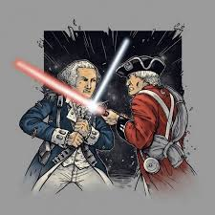
NOW ITS ON!

Slide 11
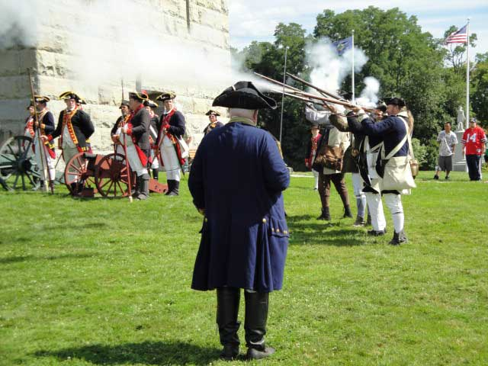
The End!

