Slide 1
Union divided
Note: There ARE some actual photographs from the Civil War in this powerpoint. The Civil War was the first war with this new technology.
Civil War (1861-1865)

Slide 2
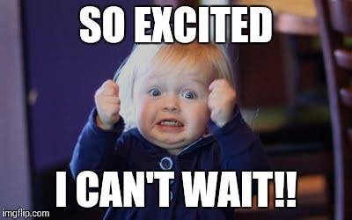
I. Summary of Causes
A) Federal vs. States Rights/Control
B) Economics
C) Slavery
D) Anticipation
E) Most thought
It would be over
Quickly!

Slide 3
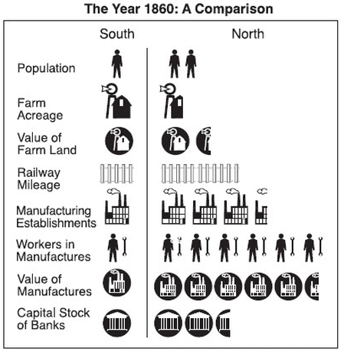
II. Advantage….
A) North
B) South
*Could you write about WHY the north won the war?

Slide 4
III. War Aims and Strategies A) Lincoln and the North

Slide 5
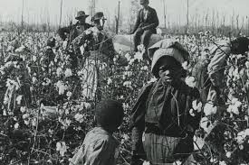
B) Confederacy did have… COTTON! And some really great generals.

Slide 6
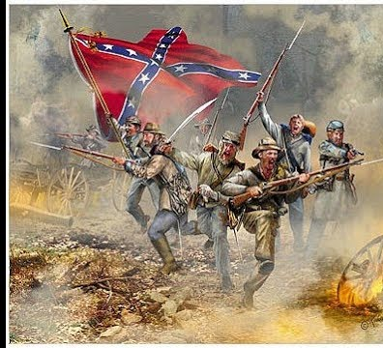
C) Bull Run (1st real battle)
A) Union army attacks South.
B) Result.. Confederates win and keep winning (under the leadership of General Robert E. Lee)
Makes people realize the war will NOT end quickly.

Slide 7
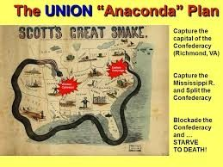
D) Anaconda Plan

Slide 8
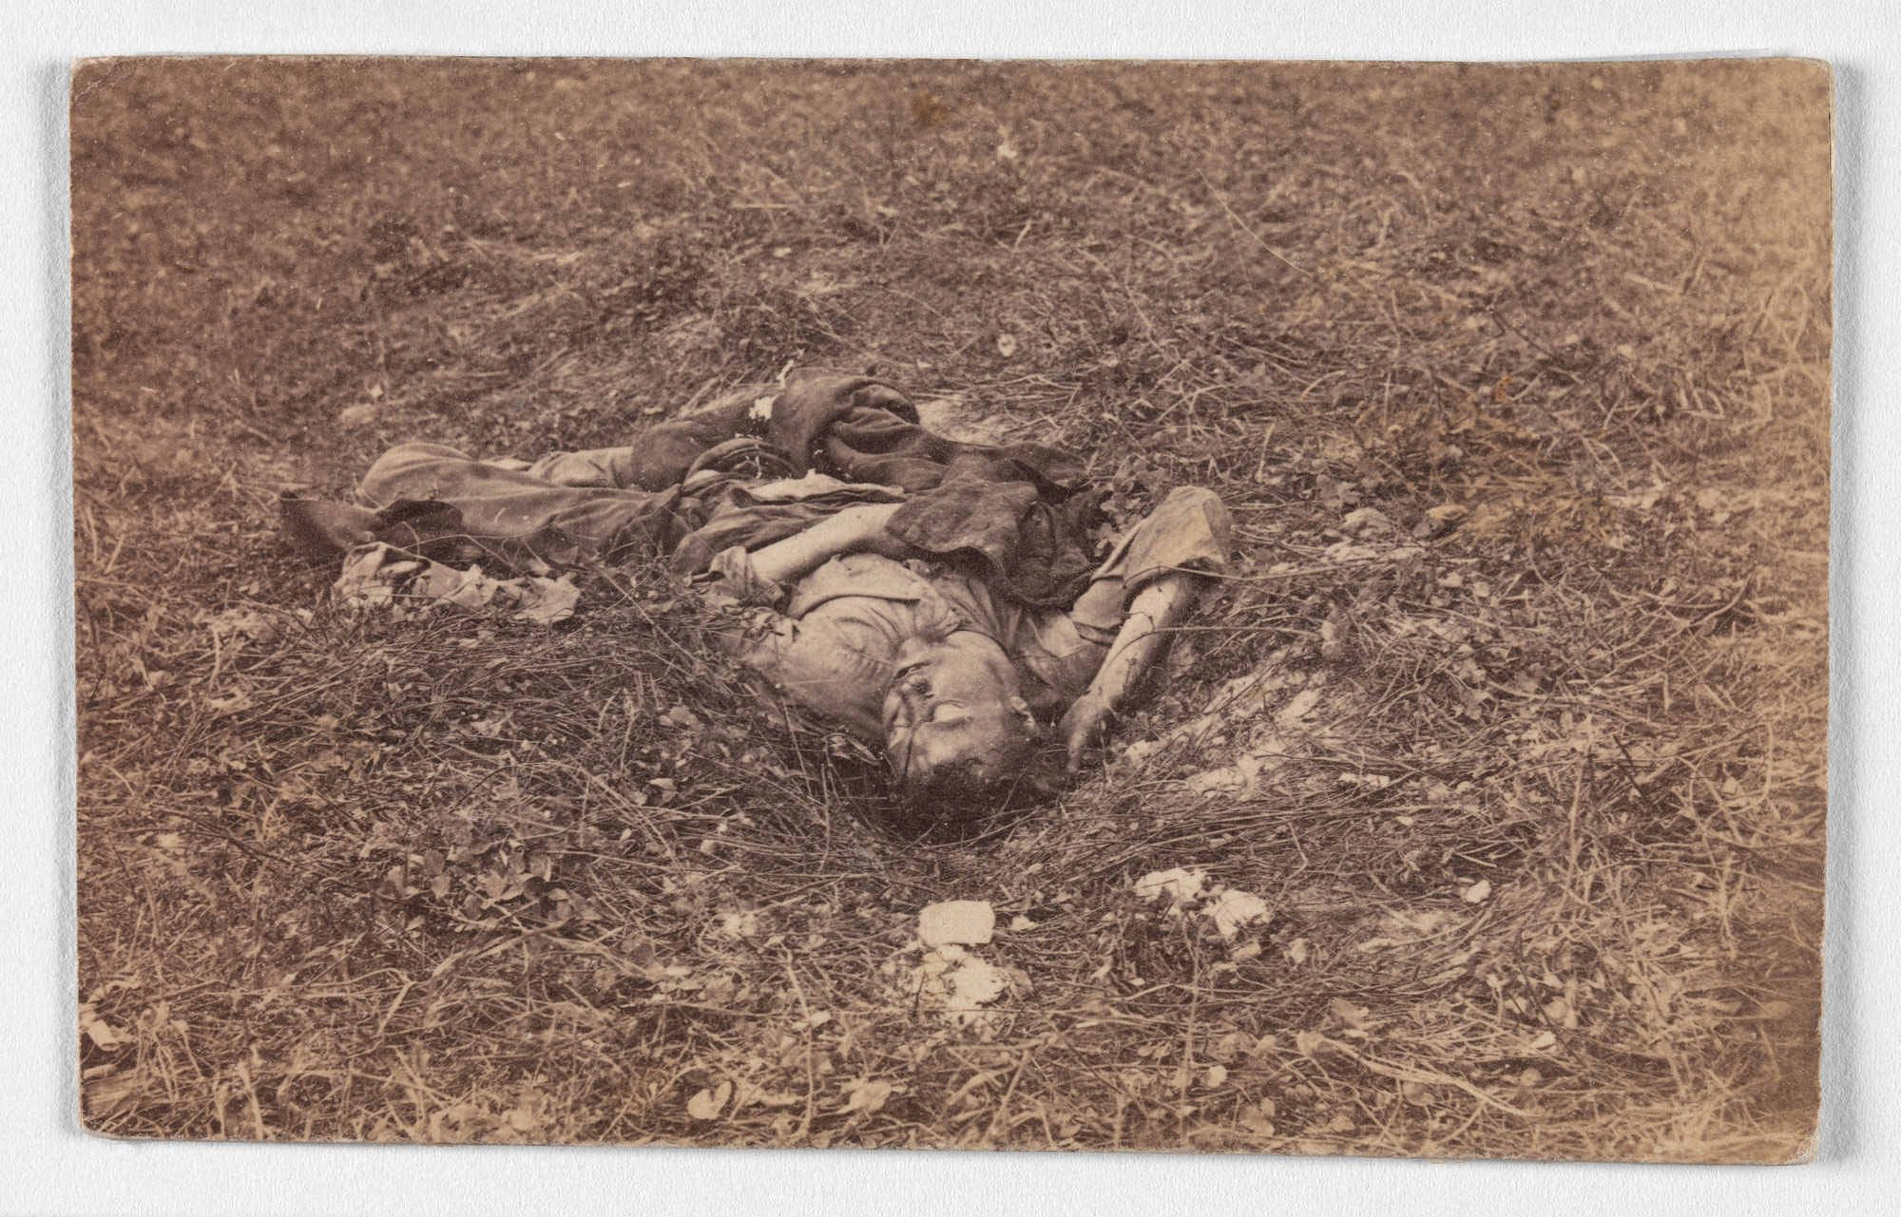
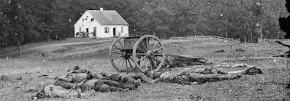
IV. 1862 – Critical Year
A) Several Battles – no clear leader
B) Battle of Antietam – September
Forces of Union General George McClellan and the Confederate troops of General Robert E. Lee met in a daylong pitched battle. By its end, more than 23,000 soldiers had been killed or wounded.

Slide 9
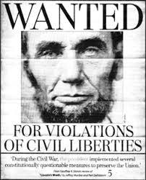
C) Problems on the Home Front (Review these if needed)
1) South
Conscription
Income Tax
Severe Shortages
Deserters
2) North
-Conscription + $300
-Income Tax
-Irish Immigrants and Draft Riots
-Copperheads (Northern Democrats)
-Lincoln expands his power:
*martial law in Kentucky
*”writ of habeas corpus” suspended

Slide 10
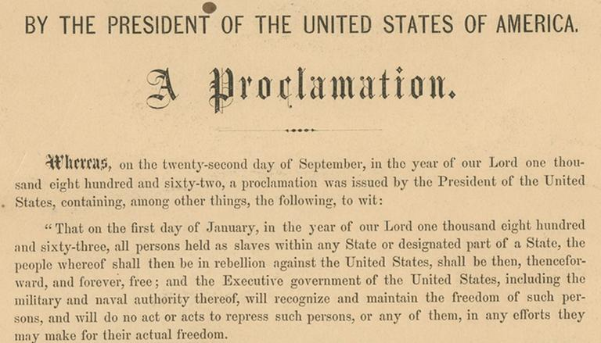
V. 1863 – The Tide turns to the North
A) Emancipation Proclamation

Slide 11
A) Emancipation Proclamation – Copy and skip at least 1 line between each.
1 – What was it?
2 – Who did it actually free?
3 – Moral Purpose?
4 – Impact on the Union Army?
5 – Impact on Southern Strategy (England)?
Use Video: Kahn Academy (see link below)
https://www.youtube.com/watch?v=fYXqj_UPsXg

Slide 12
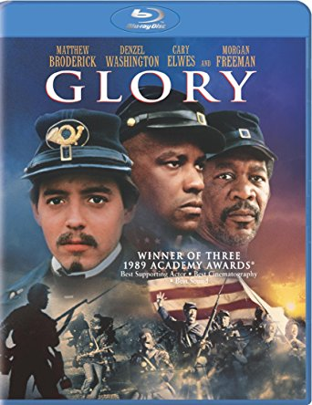
Hope you learned something from it!

Slide 13
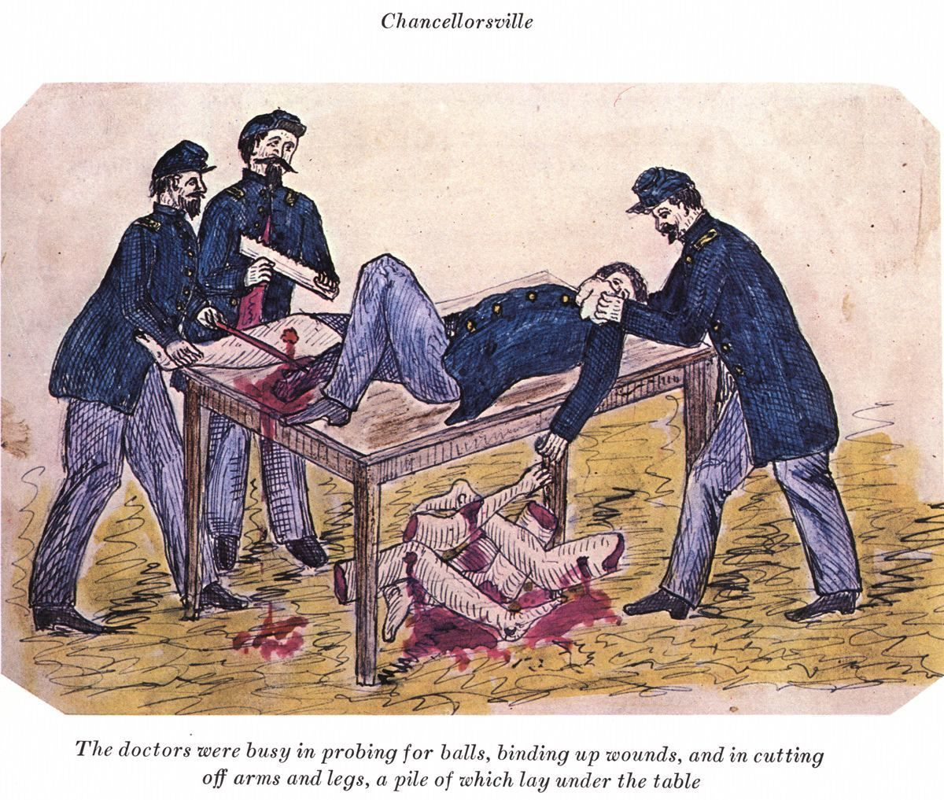
B) Union loses some battles but South runs out of time
Runs out of supplies and men
Battle of Gettysburg (Lee invades Pennsylvania)
*Bloodiest Battle of the War
*48,000 Casualties
*Union Victory
Lincoln’s Gettysburg Address:
(one of the shortest and most famous speeches of all time)
TAKE A MOMENT TO READ IT ON THE NEXT SLIDE!

Slide 14
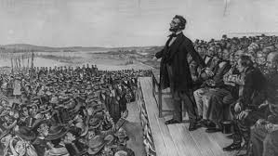
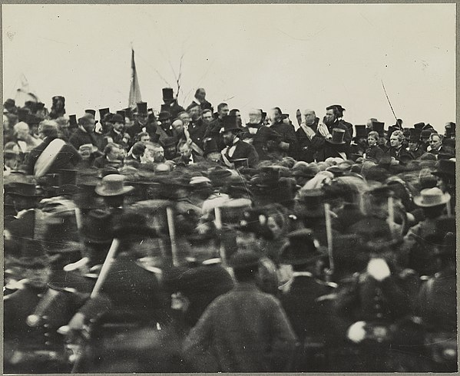
Lincoln in real photograph at Gettysburg

Slide 15
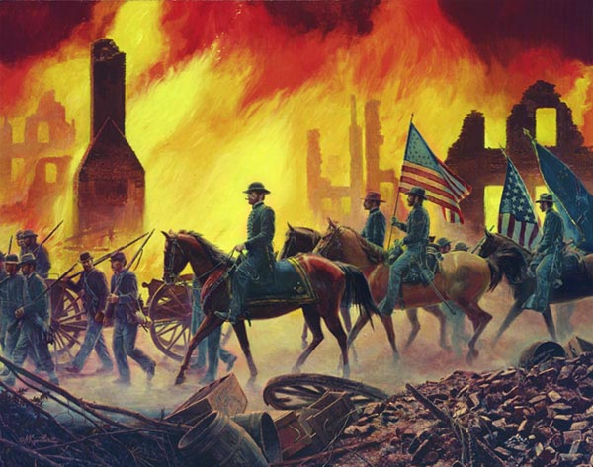
VI) 1864/5 – North Dominates
A) South –
Confederate Army –
B) Sherman’s March to the Sea “Scorched Earth Policy”

Slide 16
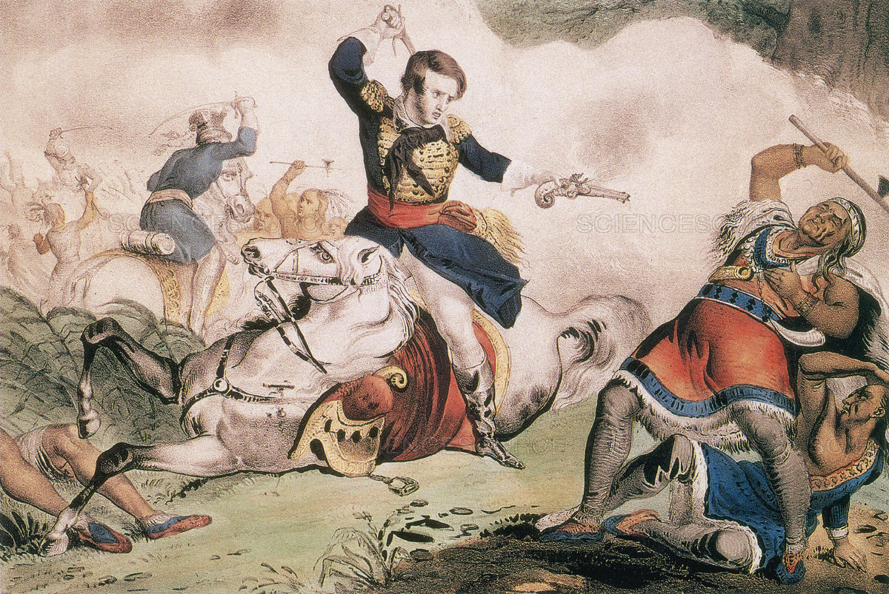
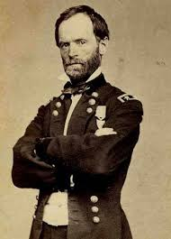
TRIVIA TIME!!!! What was General William T. Sherman’s Middle Name?
William Tecumseh Sherman

Slide 17
C) Lincoln – 1864 Election
D) Appomattox – Surrender of the Confederate army (April 1865)
E) 5 days later…

Slide 18
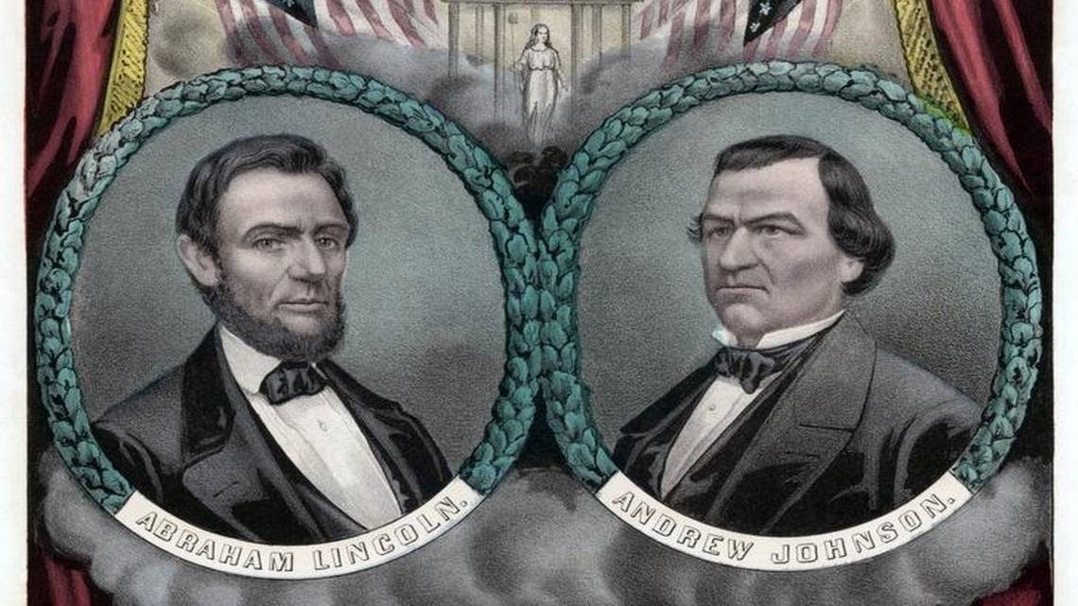
F) Lincoln’s Vice-President: Andrew Johnson become president.
Big Problem for AFTER the civil war…

Slide 19
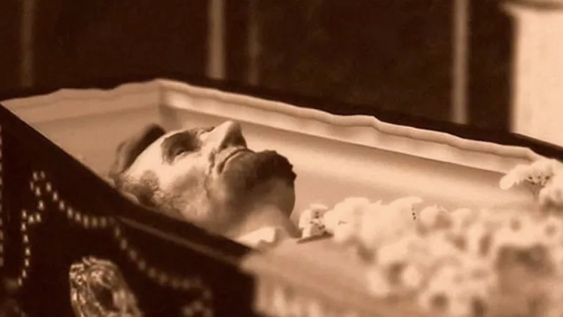
The End!

